Slide 1
Subtopic 1 – Multiples and Factors
LEARNING OUTCOME: To understand what multiples of whole numbers are
Objectives:
Find multiples of whole numbers.
Recognise multiples of numbers.
Look at problem solving questions.
Keywords:
Multiples
Integers
Example 1 - I do…
Example 2 - We do…
Example 3 – You do…
Steps | Write down the first five multiples of 13 | Write down the first five multiples of 8 | Write down the first five multiples of 7
1) Start with the number you are finding the multiples of. This is always the first multiple.
2) To find the next multiple, add on the number again. Keep repeating this until you have desired number of multiples.
1.
2.
Write down the first five multiples of 2.
Write down the first five multiples of 3.
List the first five common multiples of 2 and 3.
(d) Find the lowest common multiple of 2 and 3.
Write down the first five multiples of 4.
Write down the first five multiples of 5.
List the first five common multiples of 4 and 5.
(d) Find the lowest common multiple of 4 and 5.

Slide 2
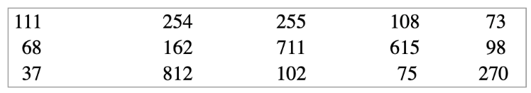
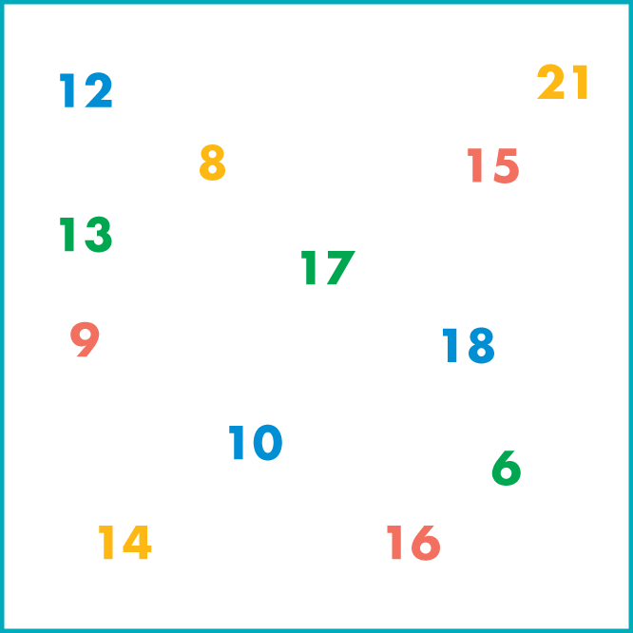

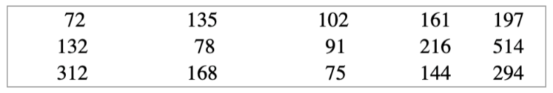
3. Write out the first five multiples of each number.
4. Write down the numbers from the box below that are multiples of:
3
7
9
11
16
2
3
5
9
5. Choose the number from the box that fits each of these descriptions (one number per description).
a multiple of 3 and a multiple of 4
a square number and an odd number
a factor of 24 and a factor of 18
a prime number and a factor of 39
an odd factor of 30 and a multiple of 3
a number with four factors and a multiple of 2 and 7
a number with five factors exactly
a triangular number and a factor of 20
an even number and a factor of 36 and a multiple of 9
a prime number that is one more than a square number
a number with factors that, when written out in order, make a number pattern in which each number is twice the one before
6. Write down the numbers from the box below that are multiples of:
7. Find the biggest number less than 100 that is a multiple of:
2
3
4
5
7
6
4
7
6
Use your calculator to help you.

Slide 3
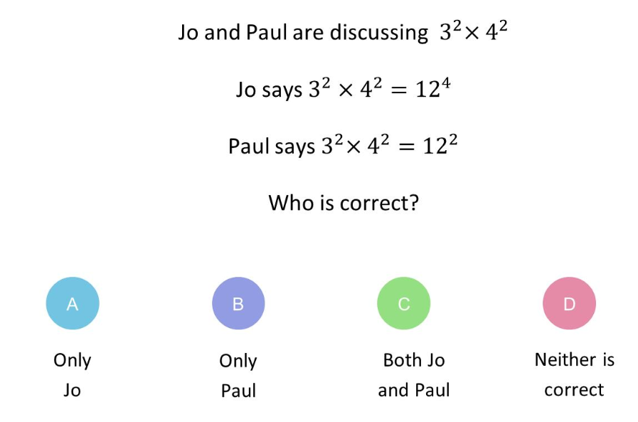
8.
Hot-dog sausages are sold in packs of 10 and hot-dog buns are sold in packs of 8. How many of each do you have to buy to have complete hot dogs with no wasted sausages or buns?
9.
A bell chimes every 6 seconds. Another bell chimes every 5 seconds. If they both chime together, how many seconds will it be before they both chime together again?
10.
Fred runs round a running track in 4 minutes. Debbie runs round in 3 minutes. If they both start together on the line at the end of the finishing straight:
When will they both be on the same line together again?
How many laps will Debbie have run?
How many laps will Fred have run?
11.
Write down the negative square root of each number.
4
49
144
1
900
Skills Check
1. Which two numbers are multiples of 6?
2. Write the first six multiples of 8
(Circle the correct answer)
7, 8
12, 18
8, 10
2, 4

Slide 4
Factors
LEARNING OUTCOME: To understand what factors of whole numbers are
Objectives:
Find factors of whole numbers.
Recognise factors of numbers.
Look at problem solving questions.
Keywords:
factors
Integers
Definition
Characteristics
Any whole number that divides exactly into another number.
Always smaller than the number, except for the number itself.
4⁶ = 4 × 4 × 4 × 4 × 4 × 4 | six lots of 4 multiplied together
6⁴ = 6 × 6 × 6 × 6 | four lots of 6 multiplied together
7³ = 7 × 7 × 7
Examples
Factor
Non - Examples
You can write a million as 1 000 000 = 10⁶.
A number multiplied by itself is the number ‘squared’. You need to know the square numbers (power 2) up to 15² = 225. How many of them can you write down from memory? You will also find it helpful to know the cubes numbers (power 3) up to 6³ = 216
The factors of 24 are 1, 2, 3, 4, 6, 8, 12 and 24.
24, 48, 72, 96 are the multiples of 24
Example 1 - I do…
Example 2 - We do…
Example 3 – You do…
Example 4- We do…
Steps | Write down the factors of 12 | Write down the factors of 18 | Write down the factors of 24 | Write down the factors of 36
Find which integer value multiply to make the value

Slide 5
1. Find the factors of each number.
a) 10 b) 28 c) 18 d) 17
e) 25 f) 40 g) 30 h) 45
i) 24 j)16
2. How many different ways can 24 chocolate bars be packed into boxes so that there are exactly the same number of bars in each box?
3. Use your calculator to find the factors of each of these numbers.
a) 120 b) 150 c) 144 d) 180
e) 169 f) 108 g) 196 h) 153

Slide 6
4.
A designer is making a box to hold 12 Christmas decorations. The decorations are to be packed in layers.
The designer wants the box to have a square base. Explain how the 12 decorations could be packed to make a square.
5.
Look at these five numbers. Use factors to explain why 32 could be the odd one out.
6.
What is the largest odd number that is a factor of 40 and a factor of 60?
Skills Check
1. Which one of the following is a factor of 16?
2. List all the factors of 32.
(Circle the correct answer)
3
6
32
4

Slide 7
Subtopic 2 – Lowest Common Multiple
LEARNING OUTCOME: To find the lowest common multiple (LCM) of a group of numbers.
Objectives:
Keywords:
Multiples
Common Multiples
Lowest Common Multiples
To understand what the LCM represents.
To find the LCM of two or more numbers.
To solve word problems using the concept of LCM
Introduction:
The lowest common multiple (LCM) is the smallest number that two (or more) numbers both divide
into evenly. Think of it as the first number that both numbers "share" when you list their multiples. The
LCM is useful when you’re adding or subtracting fractions, scheduling events, or solving problems that
involve repeated cycles or patterns.
Definition
Characteristics
The smallest integer which is a multiple of two or more positive integers.
Will be greater than or equal to the largest of the numbers.
Often abbreviated to LCM
Appears in the times table of all given numbers
Examples
Lowest Common Multiple (LCM)
Non - Examples
LCM of 8 and 12 = 24
LCM of 30 and 15 = 30
LCM of 3 and 7 = 21
LCM of 4, 5 and 6 = 60
LCM of 4 and 6 ≠ 2
LCM of 3 and 5 ≠ 1
LCM of 4 and 8 ≠ 4
Identifying the lowest common multiple of two numbers
Example 1 - I do…
Example 2 – We do…
Example 3 – You do…
Steps | Find the LCM of 3 and 7 | Find the LCM of 6 and 9 | Find the LCM of 5 and 8
1) List the first few multiples of each number. 2) Identify the multiples common to both lists, then circle the lowest common multiple. | Multiples of 3 3, 6, 9, 12, 15, 18, 21, 24, 27, 30, 33, 36, 39, 42… Multiples of 7 7, 14, 21, 28, 35, 42, 49…

Slide 8
Independent Practice
1. Find the lowest common multiple (LCM) of each of these pairs of numbers.
a) 5 and 6 | b) 2 and 7 | c) 3 and 8
d) 4 and 10 | e) 9 and 4 | f) 6 and 7
g) 25 and 35 | h) 16 and 24 | i) 20 and 28
j) 12 and 1 | k) 12 and 2 | l) 12 and 3
m) 12 and 4 | n) 12 and 5 | o) 12 and 6

Slide 9
p) 12 and 7 | q) 12 and 8 | r) 12 and 9
s) 12 and 10 | t) 12 and 11 | u) 12 and 12
v) 12 and 14 | w) 12 and 16 | x) 12 and 17
y) 12 and 40 | z) 12 and 50 | aa) 12 and 60
a) 6 and 12 | b) 3 and 8 | c) 6 and 14
d) 6 and 4 | e) 12 and 2 | f) 24 and 12

Slide 10
4. Answer the following questions:
a) Cara is buying nuts and bolts at a store. The store sells nuts in packs of 5 and bolts in packs of 10. If Cara wishes to buy the same number of nuts and bolts, what is the smallest number of nuts that she can buy?
b) A white light flashes every 28 seconds. A red light flashes every 7 seconds. They both flash at the same time. After how many seconds will they next both flash at the same time?
c) Buses to London leaves Norwich station every 30 minutes. Buses heading to Manchester leaves Norwich station every 20 minutes. At 10am a bus to London and a bus to Manchester both leave at the same time. Work out the next time that both buses leave at the same time.
d) A bus leaves Antrim Bus Station every 12 minutes. A train leaves Antrim Train Station every 18 minutes. At 8m a bus and a train leave the stations at the same time.
i) When is the next time that a bus and a train leave at the same time?
ii) Between 8am and 11am (inclusive), on how many occasions does a bus and a train leave at the same time?

Slide 11
5. Answer the following questions, the first one may be done as an example:
a) A red light flashes every 3 seconds. A yellow light flashes every 8 seconds. A green light flashes every 11 seconds They all flash at the same time. After how many seconds will they next all flash at the same time?
b) Light A flashes every 5 seconds. Light B flashes every 6 seconds. Light C flashes every 7 seconds. All three lights flash at the same time. Work out how long it will take for all three lights to flash at the same time again.
c) Robert, John and Paul start to run from the same point, in the same direction, around a circular track. If they take 126 seconds, 154 seconds and 198 seconds respectively to complete one round along the track, when will they next meet again at the starting point?
d) Three boys regularly visit the city centre in the morning. Paul goes every thirteen days, Peter goes every four days and Philip goes every two days. If they all visit the city on 1st January 2023, how many more times in 2023 will they all be in the city centre on the same morning?

Slide 12
Subtopic 3 – Highest Common Factor
LEARNING OUTCOME: To understand and be able to list the common factors of a number, identifying the highest common factor
Objectives:
Keywords:
Factor
Highest Common Factor
To understand the concept of highest common factor.
To be able to recognise common factors and identify the highest.
To be able to apply the concept of highest common factors in problem solving.
Introduction – Read and annotate:
The highest common factor (HCF), is the biggest number that can divide two (or more) numbers
evenly, with no remainder. Think of it as the largest number that both numbers "share" as a factor. The
HCF is useful for simplifying fractions, dividing things into equal parts, and finding the biggest group
that something can be split into evenly.
Definition
Characteristics
The largest integer which is a factor of two or more given positive integers.
Will be less than or equal to the smallest of the given numbers.
Often abbreviated to HCF
Examples
Highest common factor
Non - Examples
HCF of 8 and 12 = 4
HCF of 30 and 15 = 15
HCF of 4 and 15 = 1
LCM of 4, 6 and 10 = 2
HCF of 1 and 2 ≠ 2
HCF of 4 and 8 ≠ 8
HCF of 4 and 5 ≠ 20
Calculating the highest common factor of two numbers
Example 1 - I do…
Example 2 – We do…
Example 3 – You do…
Steps | Find the HCF of 10 and 15 | Find the HCF of 16 and 24 | Find the HCF of 12 and 18
1) List all the factors of each number. 2) Identify the factors common to both lists, then circle the highest common factor. | Factors of 10 1, 2, 5, 10 Factors of 15 1, 3, 5, 15

Slide 13
Independent Practice
1. Work out the highest common factor of the following pairs of numbers:
a) 4 and 14 | b) 6 and 14 | c) 6 and 9
d) 9 and 21 | e) 6 and 15 | f) 10 and 17
g) 30 and 45 | h) 40 and 60 | i) 28 and 63
j) 24 and 36 | k) 16 and 28 | l) 18 and 45
m) 150 and 200 | n) 12 and 54 | o) 90 and 270
p) 39 and 65 | q) 12 and 1 | r) 12 and 2
s) 12 and 3 | t) 12 and 4 | u) 12 and 5

Slide 14
2. Answer the following questions:
a) A PE teacher has to organise two year groups into netball teams, each separately. Year 7 has 70 students and Year 8 has 98 students. If each year group must be split equally into teams of all the same size, what is the largest team size she can use?
b) Alannah has two lengths of ribbon. One length of ribbon is 36cm long and the other length is 45cm long. Alannah wants to cut lengths of ribbon into shorter lengths that are of equal length. Alannah does not want any ribbon left over. What is the longest possible length for each of the shorter lengths of ribbon?
c) Helen thinks of two numbers. The highest common factor of her two numbers is 5. The lowest common multiple of her two numbers is a multiple of 12. Write down two possible numbers that Helen could be thinking of.
d) Lenny wants to cut identical squares, as big as he can, from a piece of paper measuring 168mm by 196mm. What is the length of each square?

Slide 15
e) Olivia thinks of two numbers. The LCM of the two numbers is 36. The HCF of the two numbers is 3. Both numbers are less than 5. Write down two possible numbers that Olivia could be thinking of.
f) Niamh thinks of a number. The HCF of the two numbers is 8. The lowest common multiple of the two numbers is a multiple of 5. Write down two possible numbers Niamh could be thinking of.
g) Here are some properties of a number: It is a common factor of 288 and 360. It is a common multiple of 4 and 6. It is larger than 25. Find the two possible numbers with these properties.
h) Kenny is thinking of two numbers greater than 10. He says: ”The highest common factor (HCF) of my two numbers is 7. The lowest common multiple (LCM) of my two numbers is 84” Write down the two numbers that Kenny is thinking of.

Slide 16
Subtopic 4 – Prime Numbers and Prime Factor Decomposition
LEARNING OUTCOME: To understand what prime numbers are and how to find LCM & HCF
Objectives:
Keywords:
factor tree
highest common factor (HCF)
index notation
lowest common multiple (LCM)
prime factor
prime factorisation
product of prime factors
unique factorisation theorem
Identify prime numbers and what Prime factors are.
identify the lowest common multiple (LCM) of two numbers.
identify the highest common factor (HCF) of two numbers.
Definition
Characteristics
Any integer that has two distinct factors, 1 and itself.
The factors are 1 and the number itself. It cannot be made by multiplying any other integers.
4⁶ = 4 × 4 × 4 × 4 × 4 × 4 | six lots of 4 multiplied together
6⁴ = 6 × 6 × 6 × 6 | four lots of 6 multiplied together
7³ = 7 × 7 × 7
Examples
Prime Number
Non - Examples
2, 3, 5, 7 and 11 are prime numbers.
Note that 1 is not a prime number.
You can write a million as 1 000 000 = 10⁶.
A number multiplied by itself is the number ‘squared’. You need to know the square numbers (power 2) up to 15² = 225. How many of them can you write down from memory? You will also find it helpful to know the cubes numbers (power 3) up to 6³ = 216
Example 1 - I do…
Example 2 - We do…
Example 3 – You do…
Steps | Write down all the prime numbers between 30 and 40 | Write down all the prime numbers between 40 and 50 | Write down all the prime numbers between 20 and 30
A prime number has exactly two distinct factors which are 1 and the number itself.
1. There is only one only prime number between 90 and 100. Write it down.
2. Use the rules for recognising multiples to decide which of these numbers are not prime numbers.
3.
When three different prime numbers are multiplied together, the answer is 105.
What are the three prime numbers?
16

Slide 17
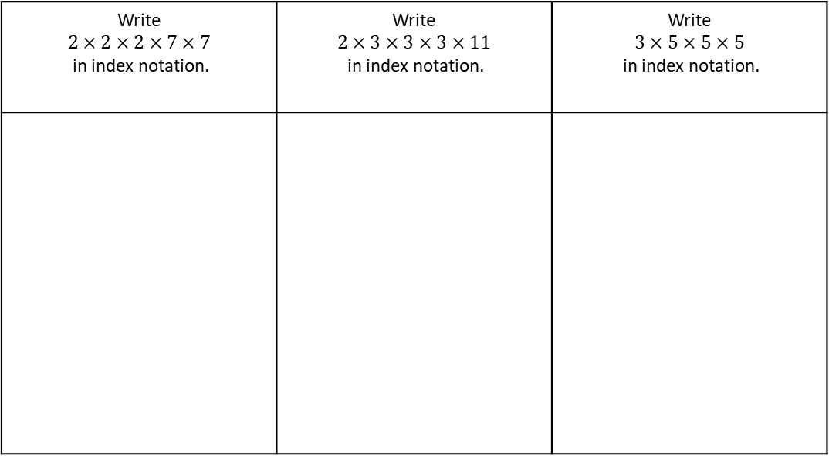


The unique factorisation theorem states that every integer greater than 1 is either a prime number or can be written as the product of prime numbers. This gives the prime factors of the number.
Consider 110. Find two numbers that, when multiplied together, give that number, for example, 2 x 55. Are they both prime? No, 55 isn’t. So take 55 and repeat the operation, to get 5 x 11. Are these both prime? Yes, so:
110 = 2 x 5 x 11
The prime factors of 110 are 2, 5 and 11 and 110 can be written in ‘prime factorized’ form as 2 x 5 x 11
Example 4 - I do…
Example 5 - We do…
Example 6 – You do…
Write $$2×2×2×7×7$$ in index notation. | Write $$2×3×3×3×11$$ in index notation. | Write $$3×5×5×5$$ in index notation.
4. Write each of these in index notation.
5. Write each of these in index notation.
$8×8×8$
$3×3×3×3×3$
$7×7×9$
$4×4×6×6$
$2×2×11×11×11$
$8×8×8×2×2×3$
$3×5×4×2×3$
$7×7×9×12×7×6$
$3×3×3×4×4×6×6$
$5×5×13×5×13×37$

Slide 18


Write the following numbers as products of primes using index notation:
Example 7 - I do…
Example 8 - We do…
Example 9 – You do…
Steps | 24 | 16 | 18
Write down the number that is being decomposed at the top.
Draw 2 lines from the number and think of two factors of the number above which are prime
Draw 2 lines from the factor which was not prime and think of two factors of that new number where one is prime (keep repeating this step until you are left with prime numbers)
Circle all prime number
Write all prime numbers as a multiplication, then put into index notation.
24
2
12
2
6
2
3
$$24=$$
$$24=$$
6. Fill in the table
Q | Number | Prime Factor Decomposition | Index Form
a) | 8
b) | 12
c) | 20
Notes:
You do needed

Slide 19
Q | Number | Prime Factor Decomposition | Index Form
d) | 9
e) | 30
f) | 36
g) | 42
h) | 56
i) | 72

Slide 20
Q | Number | Prime Factor Decomposition | Index Form
j) | 32
k) | 48
l) | 60
m) | 120
n) | 150
p) | 200

Slide 21

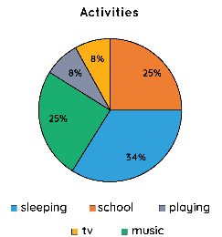

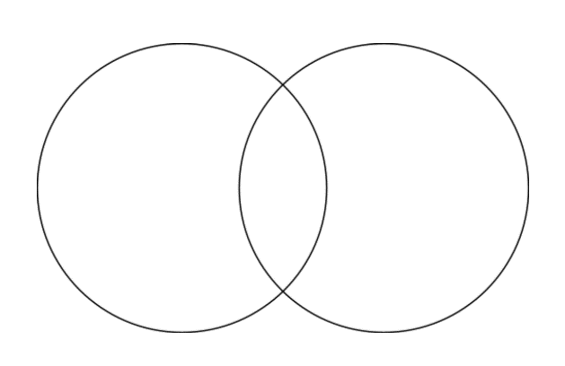
Subtopic 5 (Crossover) – HCF and LCM with Prime Decomposition
Learning outcome: To use prime decomposition to find the HCF and LCM
Objectives:
Keywords:
Prime decomposition
Common factor
Venn Diagram
To find the prime decomposition of numbers
To identify common factors and put these in Venn Diagrams
To use these Venn Diagrams to find the HCF and LCM
Introduction – Read and annotate:
This subtopic combines your existing knowledge of HCF and LCM with prime factor decomposition. You
will learn how to use Venn diagrams to calculate the HCF and LCM.
Definition
Characteristics
A Venn diagram is a diagram that uses overlapping circles to show the relationship between two or more sets.
Each circle represents one set
The intersection represents the common
elements of sets
Venn Diagram
Examples
4⁶ = 4 × 4 × 4 × 4 × 4 × 4 | six lots of 4 multiplied together
6⁴ = 6 × 6 × 6 × 6 | four lots of 6 multiplied together
7³ = 7 × 7 × 7
Non - Examples
Using Venns
Find the prime factor decomposition of the following numbers, and put these into the Venn Diagrams
Example 1 - I do…
Steps | 30 and 45
Find the product of primes for both numbers using factor trees.
Write the product of primes for both numbers.
Place the common primes in the intersection and any others in the individual circle.
30 45
Example 2 - We do…
Steps | 24 and 40
Find the product of primes for both numbers using factor trees.
Write the product of primes for both numbers.
Place the common primes in the intersection and any others in the individual circle.
24 40

Slide 22
Example 3 - You do…
Steps | 28 and 60
Find the product of primes for both numbers using factor trees.
Write the product of primes for both numbers.
Place the common primes in the intersection and any others in the individual circle.
28 60
Independent Practice
1. Find the prime factor decomposition of the following numbers, and put these into the Venn Diagrams
a) 40 and 50
b) 36 and 45
c) 18 and 24
d) 28 and 42

Slide 23
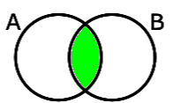
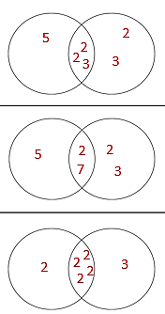
As you already know, the HCF (highest common factor) is the largest factor of two numbers.
Up until now, we have had to list all the factors of each number, and then looked through to find common factors. This works well for small numbers, but large numbers with lots of factors can make this process very difficult.
We have used Venn diagrams to organise the prime factors. It is useful to do this to help us find the HCF and LCM of two or more numbers.
The HCF can be found in the intersection of the two numbers:
To find the HCF we multiply the numbers in the intersection.
Highest Common Factor
 | Example 4 – I do… | Example 5 – We do… | Example 6 – You do…
Steps | Find the HCF of 60 and 72 using the given Venn diagram | Find the HCF of 70 and 84 using the given Venn diagram | Find the HCF of 32 and 48 using the given Venn diagram
1) Highlight the intersection of the Venn Diagram 2) Multiply the numbers in the intersection to find the HCF
60 72 70 84 32 48
Independent Practice
2. Calculate the Highest Common Factor of the following pairs of numbers.
a) 45 and 75
b) 28 and 35
45 75
28 35
3
3
5
2
7
5
5
2
c) 12 and 72
d) 36 and 52
12 72
36 52
2
2
2
3
3
2
2
13
3
3

Slide 24
Find the Highest Common Factor of the following pairs of numbers.
Example 7 - I do…
Steps | 30 and 45
Find the product of primes for both numbers using factor tress.
Write the product of primes for both numbers.
Place the integers in both products of primes in the intersection and any spare in the individual circle.
Multiply the numbers in the INTERSECTION (middle) together
Solve the calculation to give the highest common factor.
30 45
Example 8 - We do…
Steps | 24 and 40
Find the product of primes for both numbers using factor tress.
Write the product of primes for both numbers.
Place the integers in both products of primes in the intersection and any spare in the individual circle.
Multiply the numbers in the INTERSECTION (middle) together
Solve the calculation to give the highest common factor.
24
40
Example 9 – You do…
Steps | 28 and 60
Find the product of primes for both numbers using factor tress.
Write the product of primes for both numbers.
Place the integers in both products of primes in the intersection and any spare in the individual circle.
Multiply the numbers in the INTERSECTION (middle) together
Solve the calculation to give the highest common factor.
28
60
Notes:
Venn Diagram method

Slide 25
Independent Practice
3. Calculate the Highest Common Factor of the following pairs of numbers.
a) 40 and 50
b) 36 and 45
c) 18 and 24
d) 28 and 42
e) 60 and 72
f) 70 and 84

Slide 26
g) 32 and 48
h) 27 and 54
i) 64 and 100
j) 144 and 180
k) 72 and 108
l) 144 and 168

Slide 27
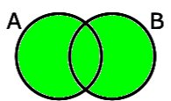
Finding the LCM by Prime Factorisation
In a similar way, we can also use Venn diagrams to find the LCM of two or more numbers.
The LCM can be found in the union of the two numbers:
To find the LCM we multiply the numbers in the union.
 | Example 10 – I do… | Example 11 – We do… | Example 12 – You do…
Steps | Find the HCF of 60 and 72 using the given Venn diagram | Find the HCF of 70 and 84 using the given Venn diagram | Find the HCF of 32 and 48 using the given Venn diagram
1) Highlight the intersection of the Venn Diagram 2) Multiply the numbers in the intersection to find the HCF
60 72 70 84 32 48
Independent Practice
6. Calculate the Highest Common Factor of the following pairs of numbers.
a) 45 and 75
b) 28 and 35
45 75
28 35
3
3
5
2
7
5
5
2
c) 12 and 72
d) 36 and 52
12 72
36 52
2
2
2
3
3
2
2
13
3
3

Slide 28
Lowest Common Multiple
Example 13 - I do…
Find Lowest Common Multiple of the following pairs of numbers.
Steps | 18 and 45
Find the product of primes for both numbers using factor tress.
Write the product of primes for both numbers.
Place the integers in both products of primes in the intersection and any spare in the individual circle.
Multiply ALL numbers in the Venn together
Solve the calculation to give the lowest common multiple.
18
45
3
Example 14 - We do…
Steps | 24 and 40
Find the product of primes for both numbers using factor tress.
Write the product of primes for both numbers.
Place the integers in both products of primes in the intersection and any spare in the individual circle.
Multiply ALL numbers in the Venn together
Solve the calculation to give the lowest common multiple.
24
40
Example 15 – You do…
Steps | 28 and 60
Find the product of primes for both numbers using factor tress.
Write the product of primes for both numbers.
Place the integers in both products of primes in the intersection and any spare in the individual circle.
Multiply ALL numbers in the Venn together
Solve the calculation to give the lowest common multiple.
28
60
28
Notes:
Venn Diagram method

Slide 29
Independent Practice
7. Calculate the Lowest Common Multiple of the following pairs of numbers.
a) 40 and 50
b) 36 and 45
c) 18 and 24
d) 28 and 42
e) 60 and 72
f) 70 and 84

Slide 30
g) 32 and 48
h) 27 and 54
i) 64 and 100
j) 144 and 180
k) 72 and 108
l) 144 and 168

Slide 31
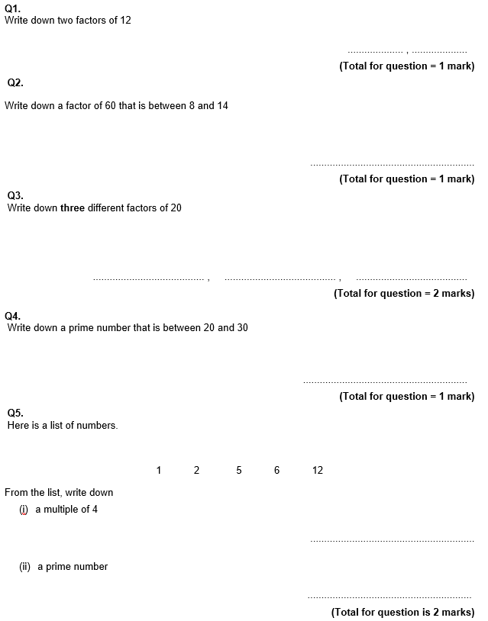
GCSE Past Paper Questions

Slide 32
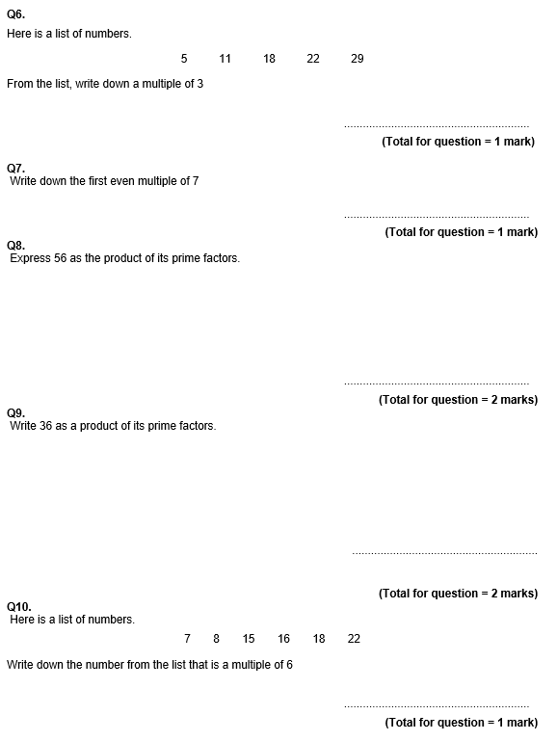

Slide 33
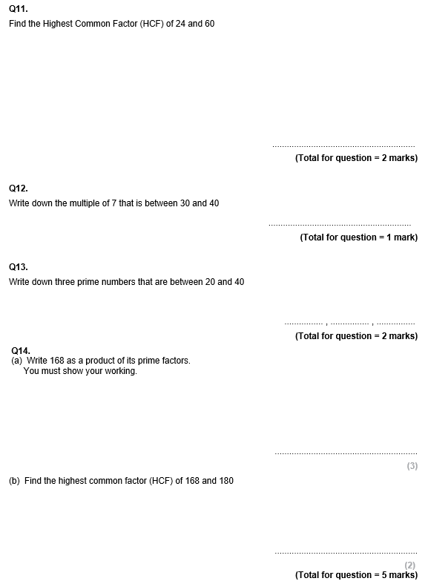

Slide 34
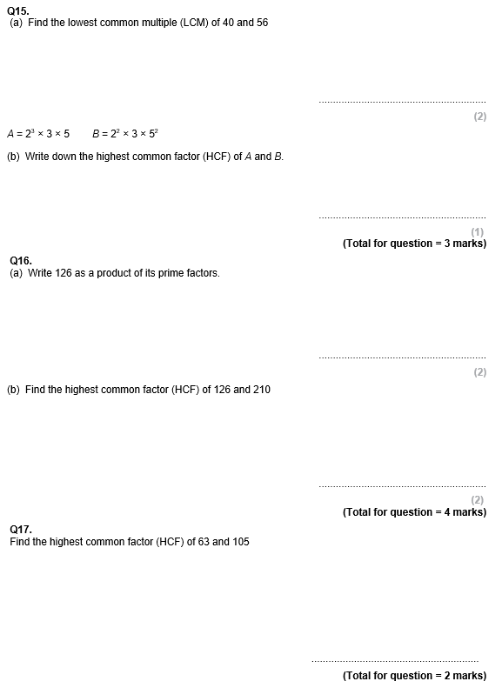

Slide 35
